Slide 1
OJT REPORT
FOR CG DEVELOPMENT
Reporter : Mao Zhengjun(毛正军)
Instructor: Liu Bing
Division : RDB-S21
2018/3/27
Notes:
Good afternoon everyone! It is my pleasure to give a presentation here. My name is Mao Zhengjun

Slide 2
RDB Organization
総合業務部
技術管理部
社長直属
（高級専家 西浩 司）
総経理：佐藤 点
副総経理：李 軍
MCU開発一部
ソリューション開発二部 (趙B,邢SE,韓SE,王SE)
MCU開発統括部
統括部長 野原知徳
BE設計部
MCU開発二部
IPソリューション
開発統括(李VP兼)
ソリューション開発一部
IP設計二部
IP設計一部
S21課
（邢松寅SE(兼）,劉氷K）
S23課
S22課
Here I am
Notes:
I am working in Department 1 Solution 2

Slide 3
agenda
Introduction
Schedule
Working Contents
Achievement
Plan And Goals
Notes:
I divided my speech into five parts.

Slide 4

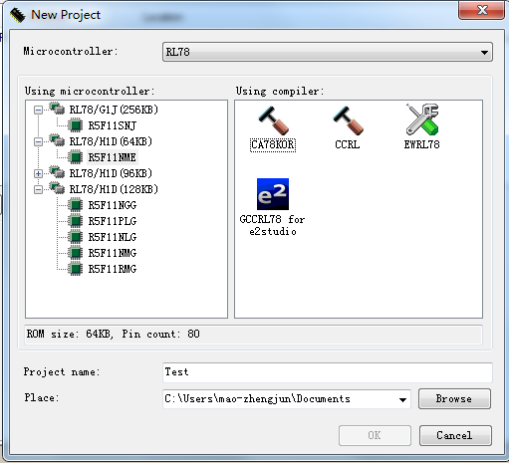
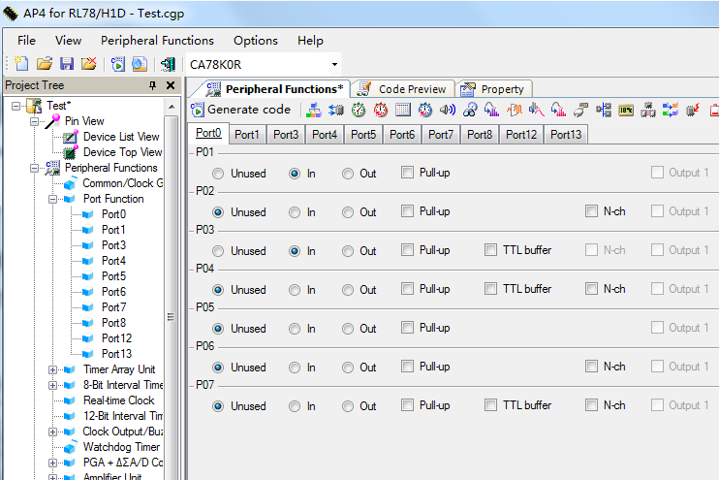
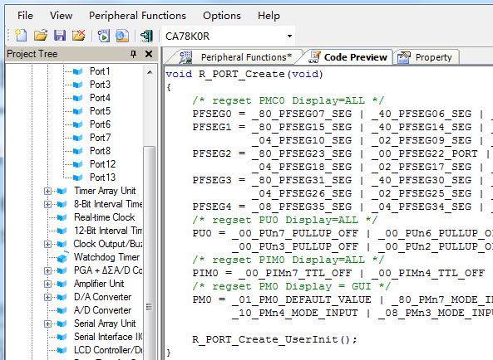
Introduction
What is the Code Generator
Code Generator is a software for generating driver code automatically by simple and convenient graphical interface configuration. CG is short for Code Generator.
How to use it
Select device
Configure peripherals
Generate driver code
Notes:
My work is mainly Code Generator development.
Customer can generate MCU driver code quickly by code generator.
This is steps for using the CG

Slide 5
agenda
Introduction
Schedule
Working Contents
Achievement
Plan And Goals
Notes:
Next is my work schedule

Slide 6
Schedule
2017 |  |  |  |  |  | 2018
July | Aug | Sept | Oct | Nov | Dec | Jan | Feb | Mar
CG development for RL78H1D
CG development for RL78G1J
Maintenance
No. | Peripherals
1 | CGC
2 | TAU
3 | 8BITIT
4 | RTC
5 | 12BITIT
6 | TMRJ
7 | SMOTD (new module)
8 | EXSD
9 | PCLBUZ
10 | WDT
11 | PGA_DSAD
12 | AMP
13 | DA
14 | AD
15 | IICA
16 | UARTMG
… | …
No. | Peripherals
1 | CGC
2 | WDT
3 | CMP
4 | AD
5 | DA
6 | PORT
7 | TAU
8 | RTC
9 | 12BITIT
10 | TMRJ
11 | TMRD
12 | TMRG
13 | PCLBUZ
14 | SAU
15 | RF
16 | IICA
… | …
No. | Ticket
1 | #2446
2 | IDE17308
3 | #1897
4 | #2429
5 | IDE18629
6 | IDE17833
… | …
My tasks
Notes:
The schedule shows most of my working plan.
There are two projects:CG development for RL78H1D and CG development for RL78G1J.
The yellow part is my tasks.
The SMOTD is a new module in all modules

Slide 7
agenda
Introduction
Schedule
Working Contents
Achievement
Plan And Goals
Notes:
After schedule is my work report.

Slide 8
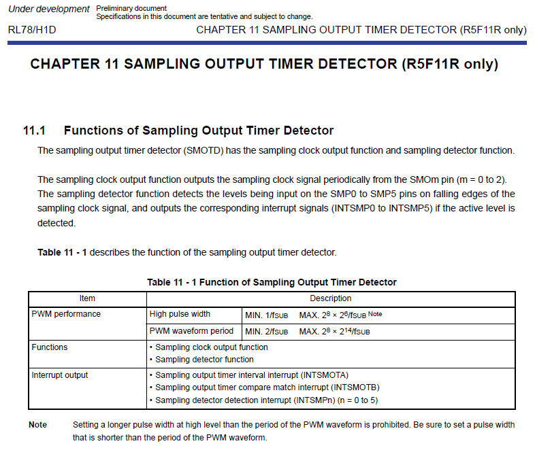
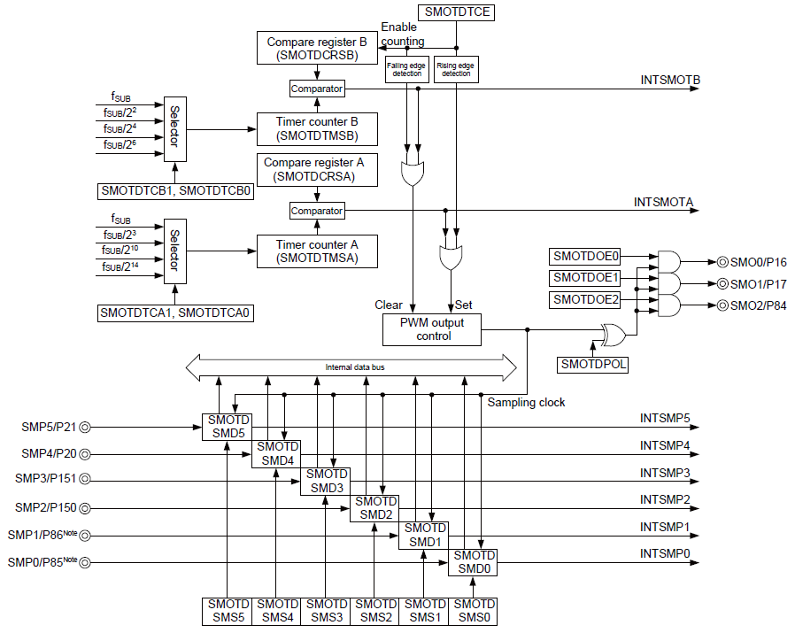
WORKing ContentS
Manual learning
Detailed design
Coding
Test
get chip's information from the manual
User’s Manual
Block diagram of peripherals
Notes:
There are 4 stages for the CG development.
The first stage is manual learning, which aims to get information about the chip from the manual.

Slide 9
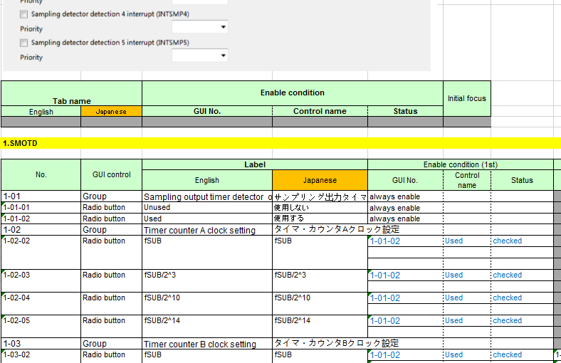
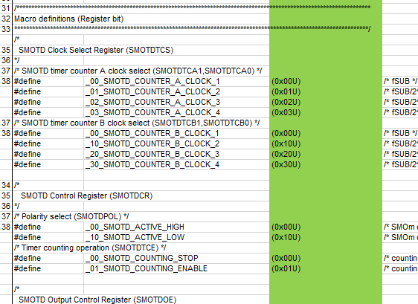
WORKing ContentS
Manual learning
Detailed design
Coding
Test
GUI detailed design
Project | Task
RL78H1D | 8BITIT
 | SMOTD
 | WDT
 | PGA_DSAD
RL78G1J | WDT
 | CMP
 | AD
 | DA
Code detailed design
Notes:
The second stage is detailed design, which includes the GUI design and the driver code design.
I designed the SMOTD module independently.

Slide 10
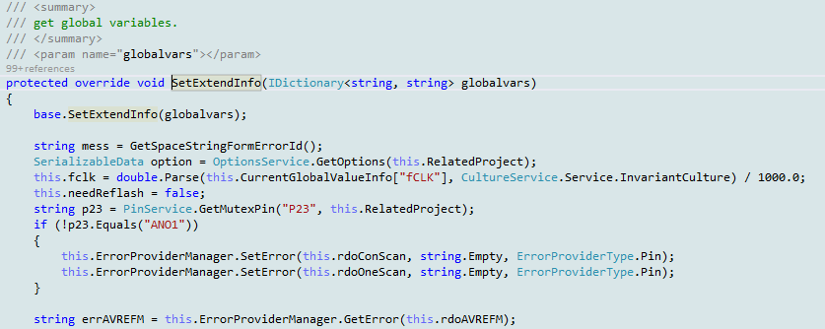
WORKing ContentS
Manual learning
Detailed design
Coding
Test
☆:Easy
☆☆:Normal
☆☆☆:Hard/New
Project | Module | Achievement（The amount of code） |  |  |  | Difficulty
 |  | New (L) | Modify (L) | Reuse (L) | Total (L)
RL78H1D | 8BITIT | 105 | 228 | 1704 | 2037 | ☆☆
 | SMOTD | 2702 | 0 | 0 | 2702 | ☆☆☆
 | WDT | 0 | 89 | 800 | 889 | ☆
 | PGA_DSAD | 1224 | 1794 | 597 | 3615 | ☆☆
RL78G1J | AD | 500 | 1300 | 4900 | 6700 | ☆☆
 | DA | 200 | 500 | 1100 | 1800 | ☆
 | CMP | 800 | 1000 | 1600 | 3400 | ☆☆
 | WDT | 10 | 30 | 890 | 930 | ☆
Notes:
The third stage is coding, which is the most important stage in CG development, and I completed the SMOTD module code independently.
the column of total shows the code amount of each module

Slide 11
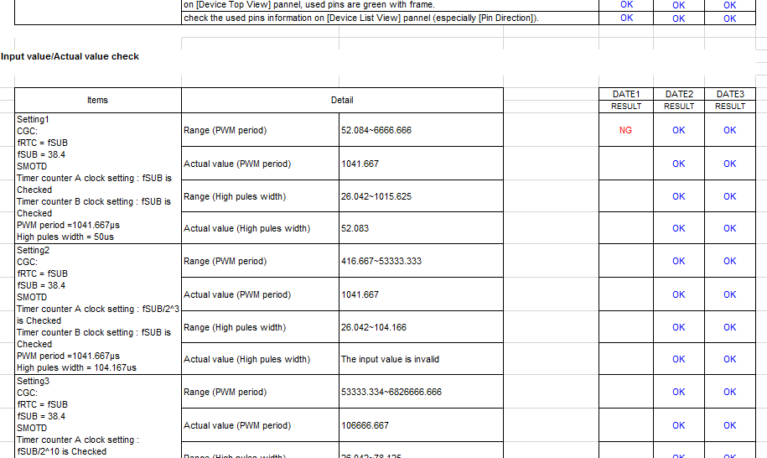
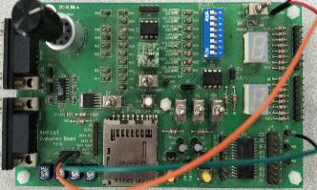
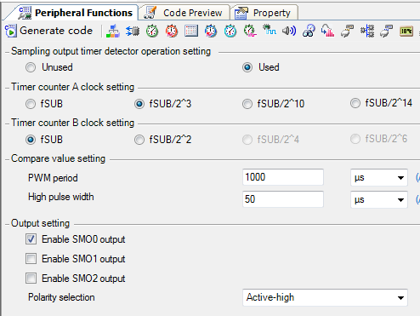
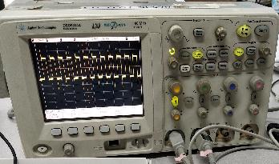
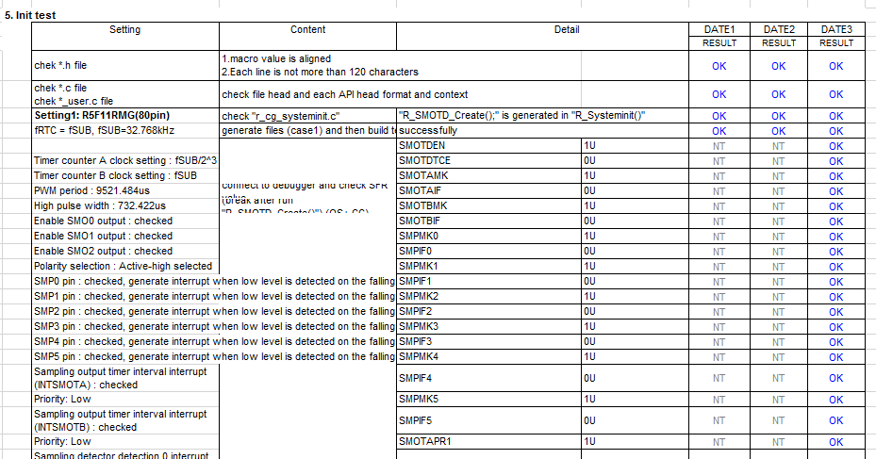
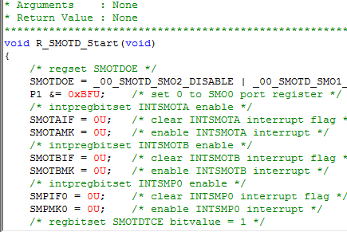
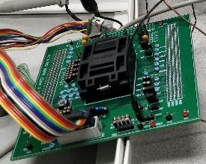
WORKing ContentS
Manual learning
Detailed design
Coding
Test
SMOTD module
Hardware Test
Unit Test
③
Input signal
①
Generate driver code
②
Download to chip
④
Output signal
Notes:
The fourth stage is test.
The purpose of the test is to check that the CG function is correct and whether meet customer requirements
Testing includes hardware test and unit test.

Slide 12
WORKing ContentS
Manual learning
Detailed design
Coding
Test
SMOTD module
Hardware Test
Project | Module | Test Case
RL78H1D | 8BITIT | 3
 | SMOTD | 2
 | WDT | 2
 | PGA_DSAD | 4
RL78G1J | AD | 2
 | DA | 1
 | CMP | 1
 | WDT | 1
③
Input signal
①
Generate driver code
②
Download to chip
④
Output signal
Notes:
The fourth stage is test.
The purpose of the test is to check that the CG function is correct and whether meet customer requirements
Testing includes hardware test and unit test.

Slide 13
agenda
Introduction
Schedule
Working Contents
Achievement
Plan And Goals
Notes:
Next,Achievement.

Slide 14

Achievement
Technique Skills
CG Development |  | Debug/Hardware test
before | After ↑↑ | before | After ↑
a little experience | can work independently | no experience | can work skillfully
Work Ability
Work independently |  | Work efficiency
before | After ↑↑ | before | After ↑↑
no experience | can work independently | no experience | can complete tasks on schedule with good quality
Notes:
I have gained a lot in technical skills and working ability since I entered the office.
Especially in parts of CG development and work efficiency

Slide 15
Achievement
Expert
Complicated
Normal
Easy
No experience
Notes:
I have gained a lot in technical skills and working ability since I entered the office.
Especially in parts of CG development and work efficiency

Slide 16
agenda
Introduction
Schedule
Working Contents
Achievement
Plan And Goals
Notes:
Finally, Plan and Goals.

Slide 17
plan and goals
Short term plans
Learn plug-in development technology based on eclipse to be ready for future development
Learn principle of complex peripherals
Such as : Timer Array Unit, Serial Array Unit
Long term goals
Strive to create first-class products
3 years
2 years
Can develop some sample frameworks and core code.
1 years
Can independently develop highly difficult modules.
Can independently develop medium difficuty modules. ✔
Notes:
I have two plans in the short term.
learning the Plug-in Development technology based on the eclipse to be ready for the future development.
studying the principle of complex peripherals
I have goals within 3 years.
Now I can develop medium difficulty module . I wish I can develop more difficult modules within two years.
After that, Within three years, I be able to develop some simple frameworks and core code.

Slide 18
Thank you!
Notes:
Thank you for watching and listening.
Thanks to my team and colleague.

Slide 19
Renesas.com

Slide 20
Q&A

